Slide 1



CNN Approach for
Breast Cancer Diagnosis in
Histopathological Dataset
conclusion
result
documentation
improvement
background
Hansen Idden
Nadhifa Sofia
Reza Anugrah Prakasa

Slide 2

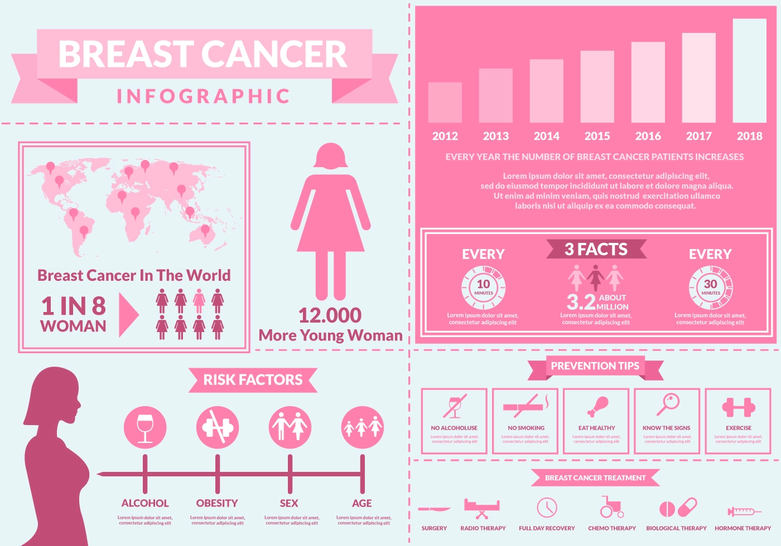
Highest Mortality
Benign/Malignant Classification
Breast cancer has the second highest mortality rate after Lung & Bronchial cancer, and about 30% of newly diagnosed cases are of breast cancer only.
The goal is to identify whether a tumor is benign or of a malignant in nature, as malignant tumors are cancerous and should be treated as soon as possible to reduce and prevent further complications.
Histopathology
result
Images are acquired by histopathology, which generally includes biopsy of the affected tissue.
documentation
background
conclusion
improvement
Human Error
Manual detection is a tedious, tiring task and most likely to comprise human error, as most parts of the cell are frequently part of irregular random and arbitrary visual angles.

Slide 3

What is the potential of computational pathology?¶
documentation
result
background
conclusion
improvement

Slide 4

What is the potential of computational pathology?¶
documentation
result
background
conclusion
improvement

Slide 5
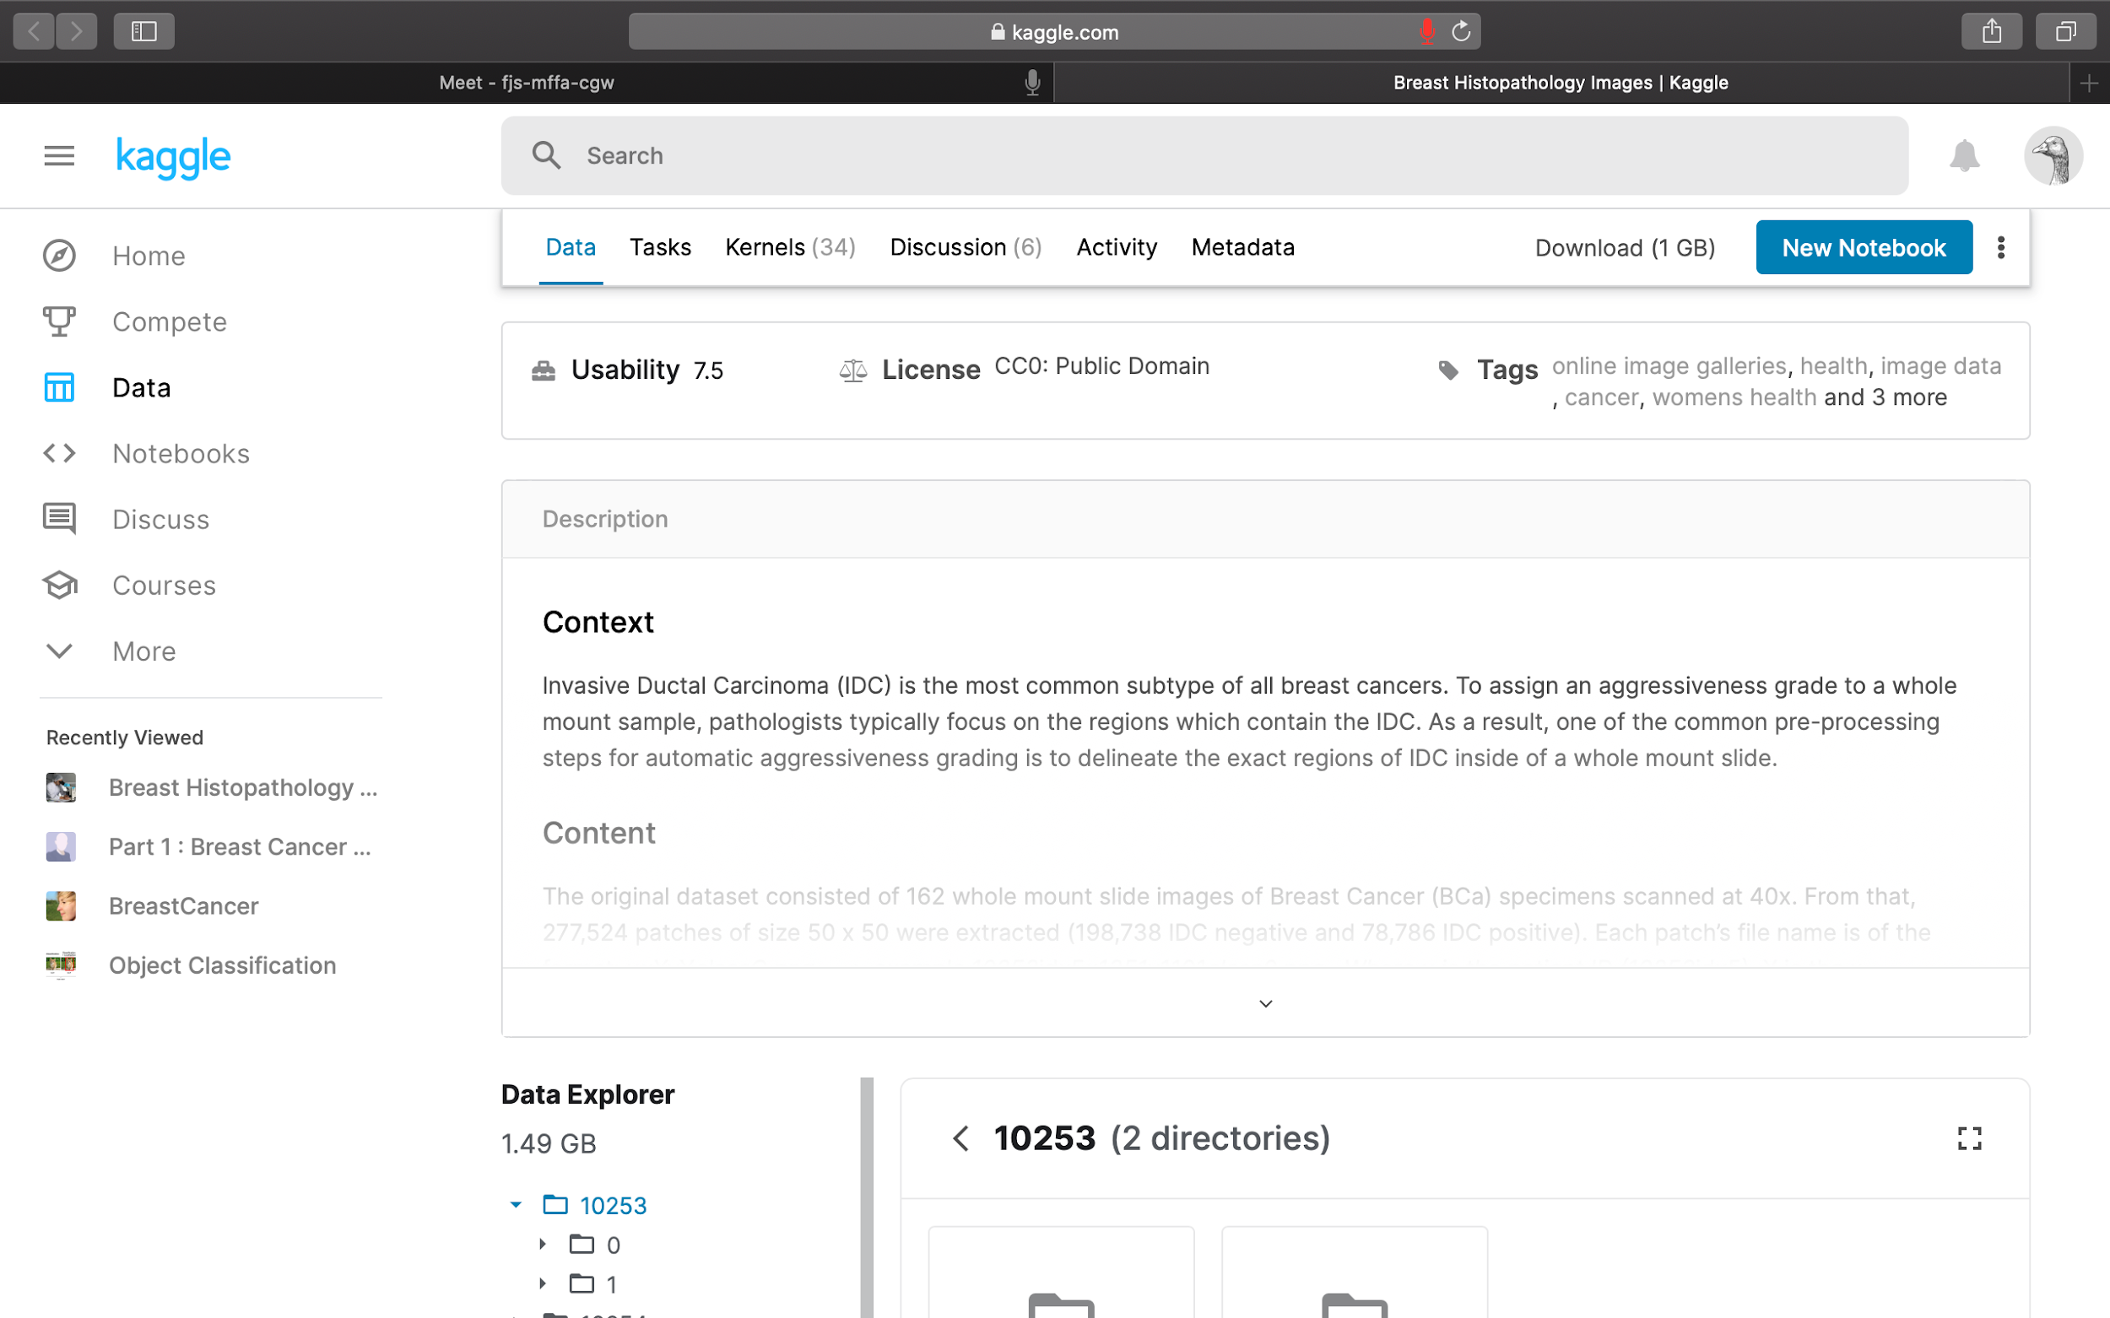
Why did we choose this dataset?
The original dataset consisted of 162 whole mount slide images of Breast Cancer (BCa) specimens scanned at 40x. From that, 277,524 patches of size 50 x 50 were extracted (198,738 IDC negative and 78,786 IDC positive). Each patch’s file name is of the format: uxXyYclassC.png — > example 10253idx5x1351y1101class0.png . Where u is the patient ID (10253idx5), X is the x-coordinate of where this patch was cropped from, Y is the y-coordinate of where this patch was cropped from, and C indicates the class where 0 is non-IDC and 1 is IDC.
documentation
result
background
conclusion
improvement

Slide 6
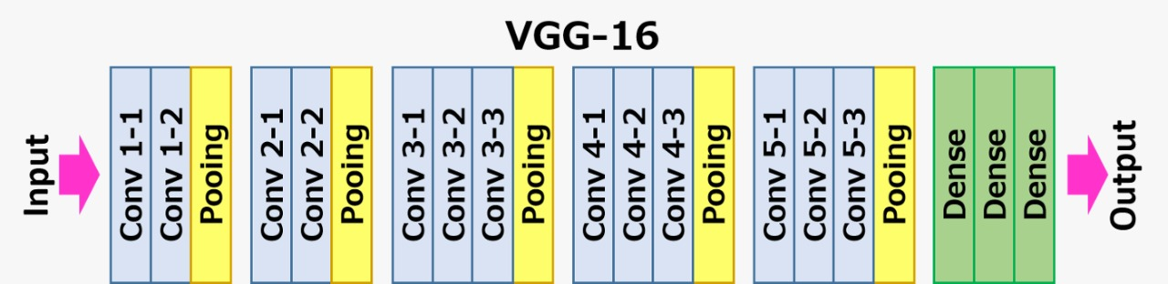
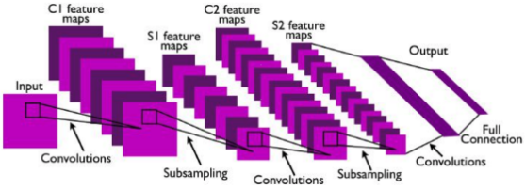
CNN Implementation Baseline (VGG 16 Architecture)
conclusion
results
documentation
improvement
background
Convolution Layer
Pooling Layer (Subsampling)
Full Connection Layer
Notes:
- Convolutional layer computes the output of neurons connected to local regions in the input, each one computing a dot product between their weights and the region they are connected to in the input volume. The set of weights which is convolved with the input is called filter or kernel. Every filter is small spatially (width and height), but extends through the full depth of the input volume.
- Pooling (subsampling), Thus, reducing the number of parameters and computations required by the network helps in the overfitting control. The pooling layer downsamples the volume spatially, independently in each depth slice of the input volume. Thus, the pool operator resizes the input along width and height, discarding activations.
- Fully connected layer, This type of layer is standard in a regular neural network. The last fully-connected layer holds the net output, such as probability distributions over classes.

Slide 7
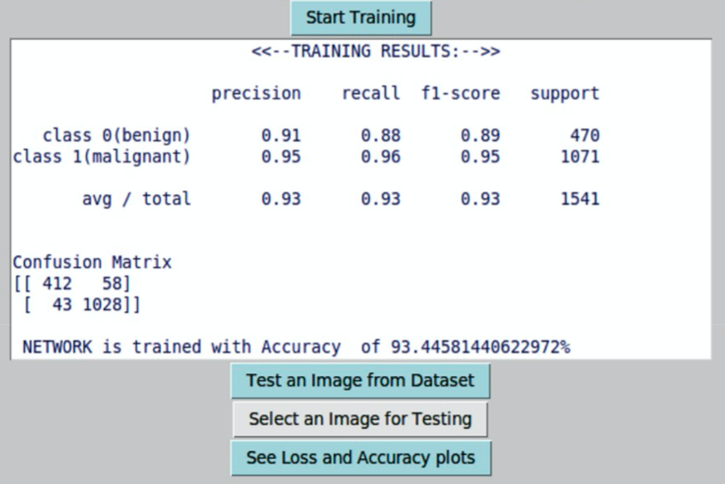
conclusion
results
documentation
improvement
background

Slide 8
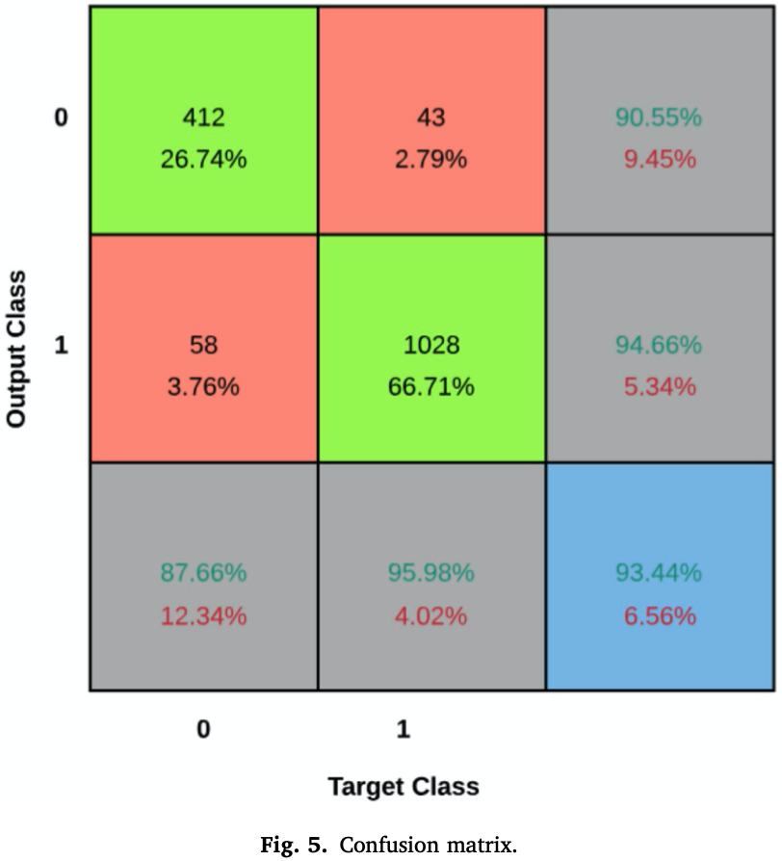
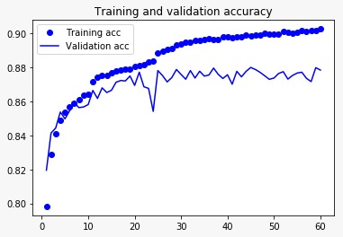
conclusion
results
documentation
improvement
background

Slide 9
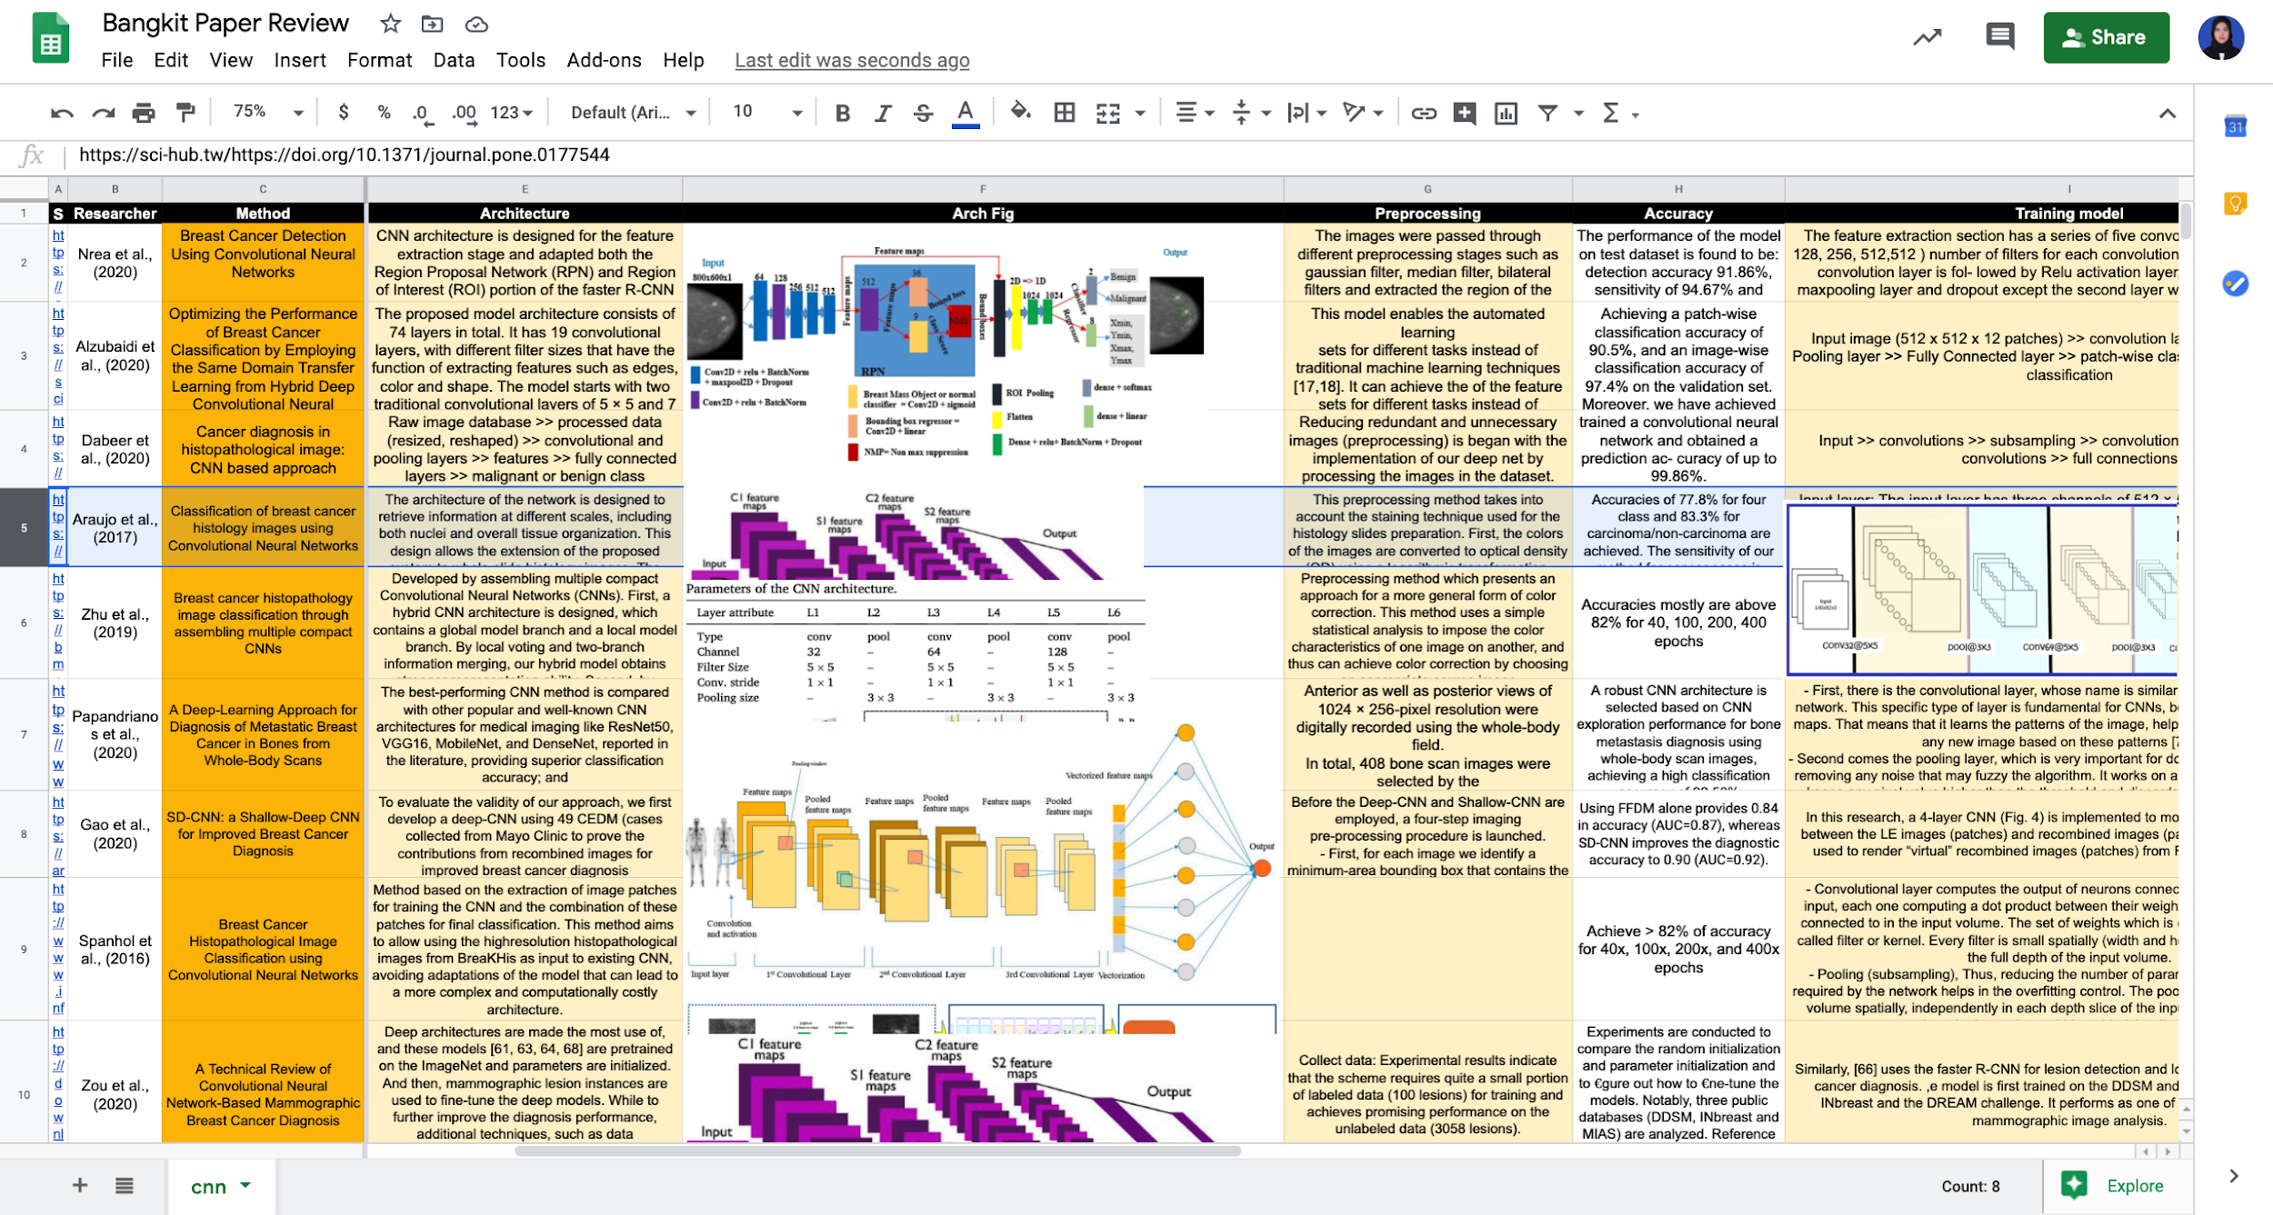
conclusion
results
documentation
improvement
background
https://bit.ly/bangkit-paper-review

Slide 10
Alzubaidi et al., (2020)
Papandrianos et al., (2020)
Optimizing the Performance of Breast Cancer Classification by Employing the Same Domain Transfer Learning from Hybrid Deep Convolutional Neural Network Model
A Deep-Learning Approach for Diagnosis of Metastatic Breast Cancer in Bones from Whole-Body Scans
Zou et al., (2020)
Araujo et al., (2020)
A Technical Review of Convolutional Neural Network-Based Mammographic Breast Cancer Diagnosis
Classification of breast cancer histology images using Convolutional Neural Networks
conclusion
results
documentation
improvement
Zhu et al., (2019)
background
Dabeer et al., (2020)
Breast cancer histopathology image classification through assembling multiple compact CNNs
Cancer diagnosis in histopathological image: CNN based approach
Gao et al., (2020)
Spanhol et al., (2016)
SD-CNN: a Shallow-Deep CNN for Improved Breast Cancer Diagnosis
Classification of breast cancer histology images using Convolutional Neural Networks
Nrea et al., (2020)
Breast Cancer Detection Using Convolutional Neural Networks
https://bit.ly/bangkit-paper-review

Slide 11
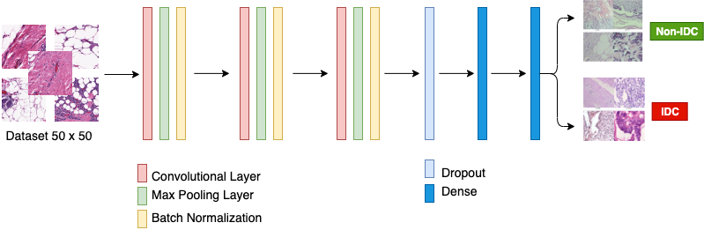
Adjusting learning rate
In order to enhance accuracy; 1x10⁻⁵ , 1x10⁻⁴, 1x10⁻³, 1x10⁻², 1x10⁻¹
Change optimizer
By using Stochastic Gradient Descent
Adjusting epochs
Reduce epochs from 60 to 25
conclusion
result
documentation
improvement
background
Add Batch Normalization
Adding batch normalization each layer

Slide 12
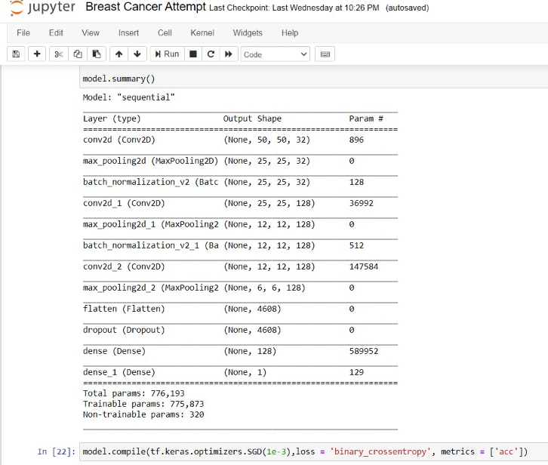
We propose these neural networks;
conclusion
result
documentation
improvement
background

Slide 13
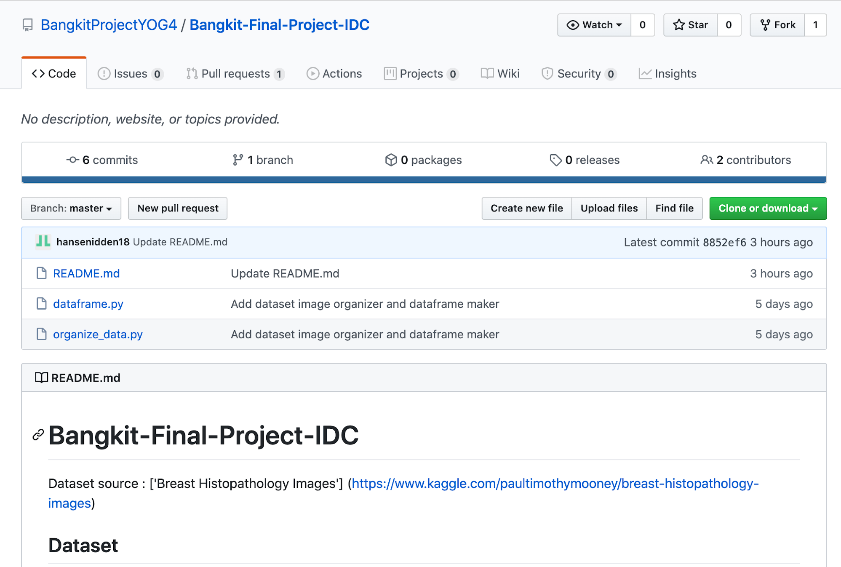
Project resource and docs
Lariviere and Poel (2005)
Alshamsi (2014)
Predicting customer retention and profitability by using random forests and regression forests techniques
Predicting Car Insurance Policies Using Random
Forest
conclusion
documentation
result
improvement
background
Fang et al., (2016)
Lin et al., (2017)
Customer profitability forecasting using Big Data analytics: A case study of the insurance industry
An Ensemble Random Forest Algorithm for Insurance Big Data Analysis
Harjai et al. (2019)
Chemchem et al., (2019)
Detecting Fraudulent Insurance Claims Using
Random Forests and Synthetic Minority
Oversampling Technique
Combining SMOTE sampling and Machine
Learning for Forecasting Wheat Yields in France
Link : https://github.com/BangkitProjectYOG4/Bangkit-Final-Project-IDC

Slide 14
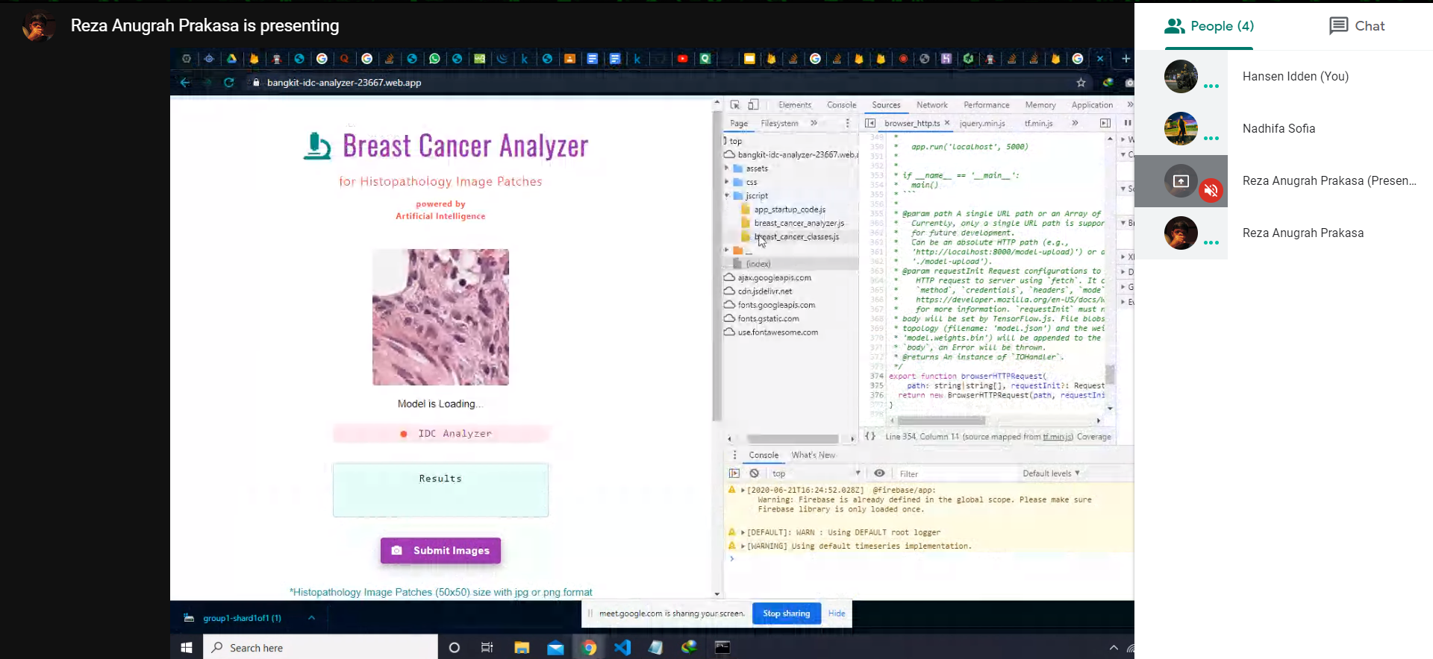
Meeting documentation ()
First 2 Week (3 times/week)
Last Week (every day)
result
documentation
improvement
background

Slide 15
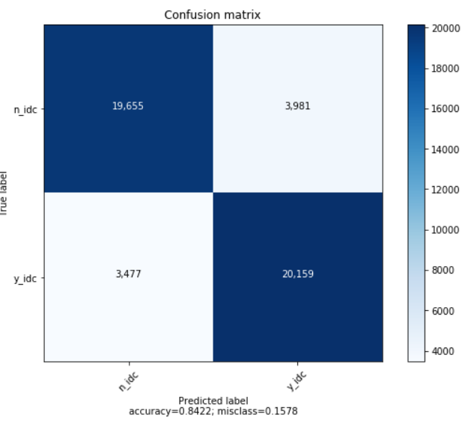
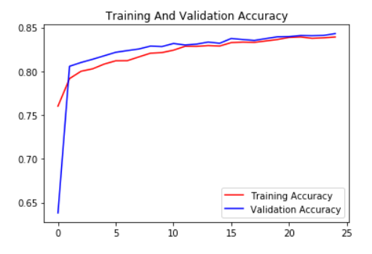
From this project, we could achieve as 84% of both training and validation accuracy. It can be improved by using more HD patches as the inputs, but it also has drawback as it is computationally expensive.
Breast cancer detection by using digital/digitized histopathology images is a milestone in the field of medical pathology. It has also opened a door to new opportunities for research as there are many undiscovered areas that can be revealed by techniques and tools of machine learning and deep learning. We may obtain improved results by altering the network design and parameters. As an improvement to the proposed method, one can implement an autoencoder instead of manually reducing image size. It can compress data without losing the prominent features, because autoencoders can re-generate up to 90% of the original image. From the point of method improvement, we can incorporate spectral imaging.
Our confusion matrix :
Data Collection
Preprocessing
the process of gathering and measuring information on targeted variables in an established system, which then enables one to answer relevant questions and evaluate outcomes.
step in which the data gets transformed, or Encoded, to bring it to such a state that now the machine can easily parse it
result
conclusion
result
documentation
conclusion
improvement
documentation
improvement
background
background
Modeling
Evaluation
Modeling in machine learning is an iterative phase where a data scientist continually train and test machine learning models to discover the best one for the given task
Model evaluation aims to estimate the generalization accuracy of a model on future (unseen/out-of-sample) data

